Slide 1



Swami Sahajanand College of Computer Science
(Affiliated to: Maharaja Krishnakumarsinhji Bhavnagar University)
Project Presentation on
“RESALE RETREATE”

Slide 2
SUBMITTED IN FULFILLMENT FOR AWARD OF
DEGREE
IN
Bachelor of Computer Application
(2024-2025)
Submitted By:
1.Rajpura Krisha
(ID: 3020206120220247)
2.Trivedi Manya
(ID: 3020206120220307)

Slide 3

INDEX
1. Introduction
1.1 Objective
1.2 Purpose
1.3 Scope
1.4 Applicability
2. Requirement And Analysis
2.1 Problem definition
2.2 Hardware Software Requirement
3. System design
3.1 DFD / ER / Use Case
3.2 Data Dictionary
3.3 Software Screen Shots
4. Conclusion
4.1 Limitation of system
4.1 Future Scope of system
4.1 Bibliography

Slide 4
Introduction
Background
The "Resale Retreate" project is a platform designed to revolutionize the sale and purchase of used items.
Focuses on supporting the principles of reuse and recycling.
Aims to reduce waste and promote sustainable consumption practices.
Connects individuals who value the life and history of pre-loved goods.
Offers an alternative to the fast-paced consumer culture by cherishing and preserving vintage and gently used products.
Seeks to make a positive environmental impact by reducing the carbon footprint associated with manufacturing new items.
Fosters meaningful connections between buyers and sellers.
Objective
Bring vintage or gently used products in good condition into more homes.
Allow customers to list items for sale effortlessly.
Enable other users to explore and purchase from a diverse range of listed products.
Extend the life of items and connect like-minded individuals who appreciate sustainability.
.

Slide 5
Purpose & scope
Promote Reusability:
Users can list products for sale by providing essential details and uploading images.
Facilitates the reusability of items, preventing them from ending up in landfills.
Encourage Recycling:
Simplifies the process of buying and selling pre-owned goods.
Fosters a culture of recycling, where products find new homes instead of being discarded.
.
User-Friendly Interface:
Ensures customers can easily upload their items for sale and navigate through various product listings.
Enhances user engagement and satisfaction
Second Chance for Precious Goods:
Provides items with sentimental or significant value a second chance to be cherished by new owners.
Adds a personal touch to the process, creating meaningful connections between buyers and sellers.
Environmental Impact:
Supports the circulation of used products, significantly reducing the environmental footprint.
Contributes to a more sustainable and eco-friendly future.
.

Slide 6
Problem Definition
Today everything is getting expensive and its not always possible or intelligent to buy new items . this way people can buy many day to day items in reasonable prize and good condition .
Requirement specification
User can upload their items in specific category
User can list their product on sale by providing its details and other specifications
Other user can purchase all the listed items which fits them the best.
.

Slide 7
Software Hardware Requirement
software requirements :
Hardware requirements :
Operating System | Windows 11
Front end | HTML ,CSS , JavaScript
Backend | Php
Editor | Notepad ++
Documentation tool | Microsoft word
Server | XAMPP
Processor | 64-bit, CORE i3, 1.70GHz
RAM | 8 GB
Storage | 80 GB

Slide 8
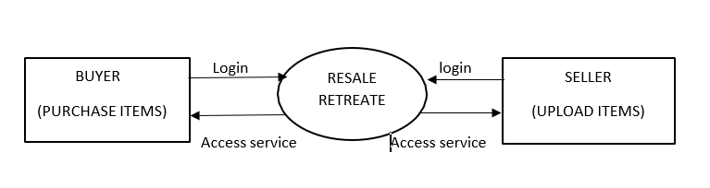
DFD
0 or Context Level DFD
.
Data flow diagrams are used to understand the flow and mechanism of the website ,
Notations for Data flow diagrams are as follows…
Process : the processes are defined inside the circles.
Entity : the external entities are mentioned into rectangles .
Arrow : the arrows indicates the flow of diagrams
Datastore : the open ended rectangles shows the logical files and their viewing state .

Slide 9
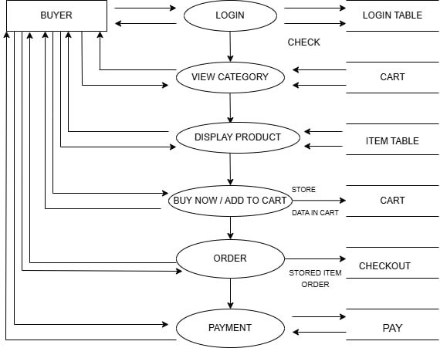
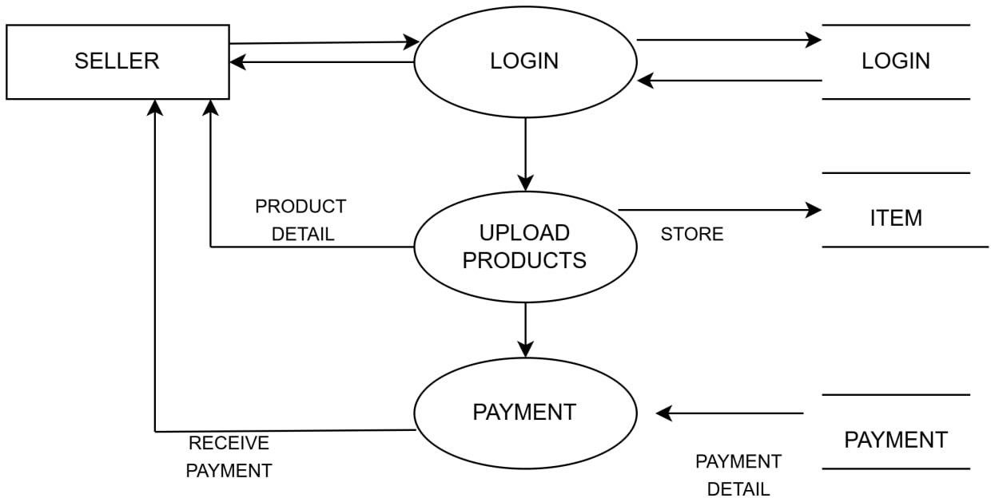
1st Level DFD
1) Buyer
2) Seller
.

Slide 10
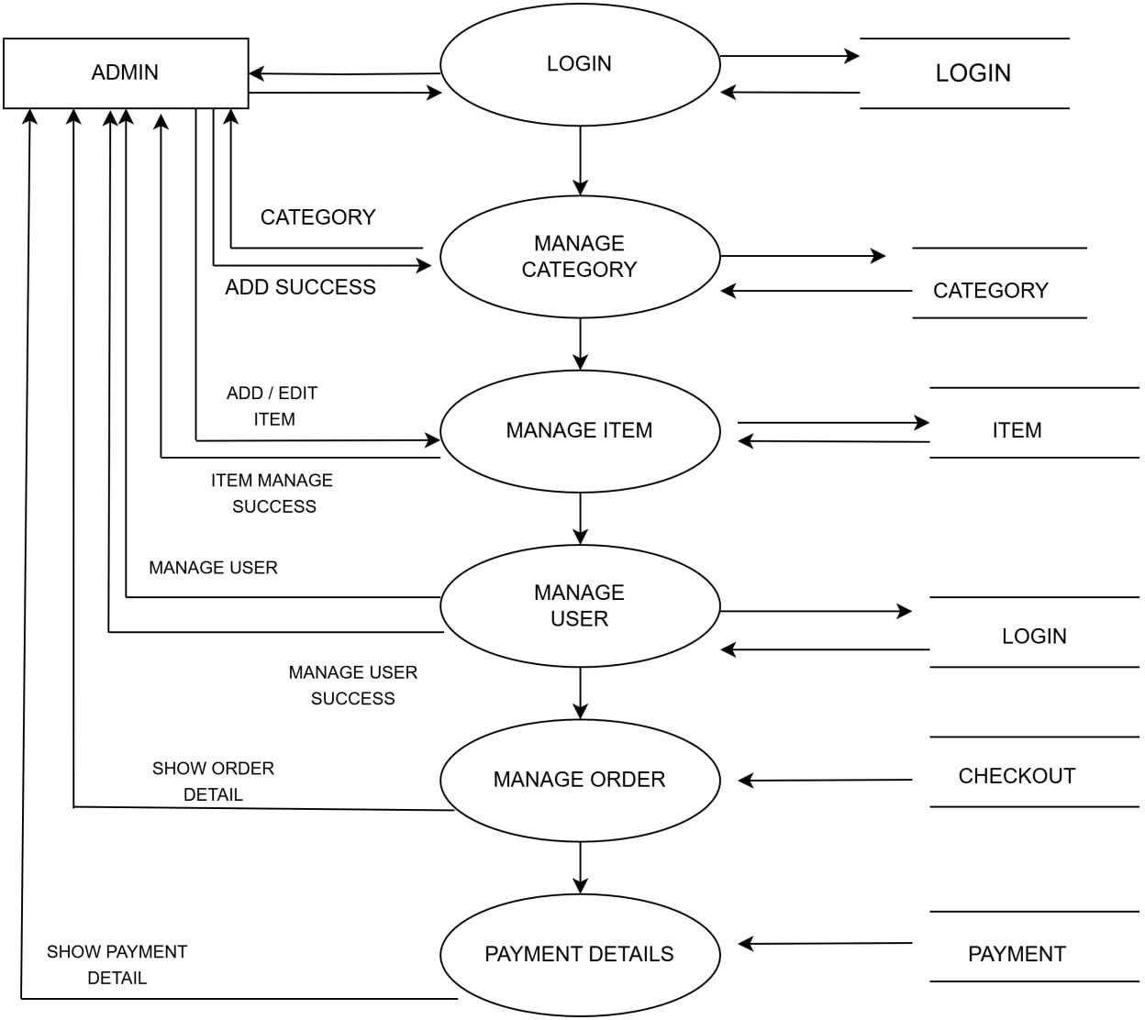
3) Admin
.

Slide 11
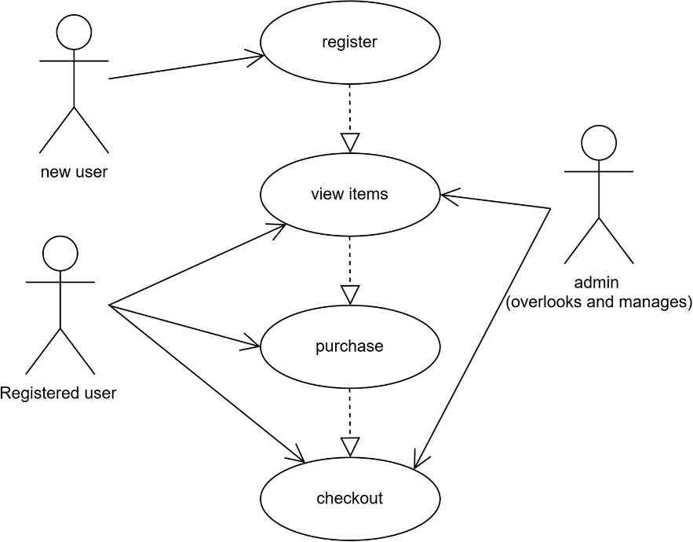
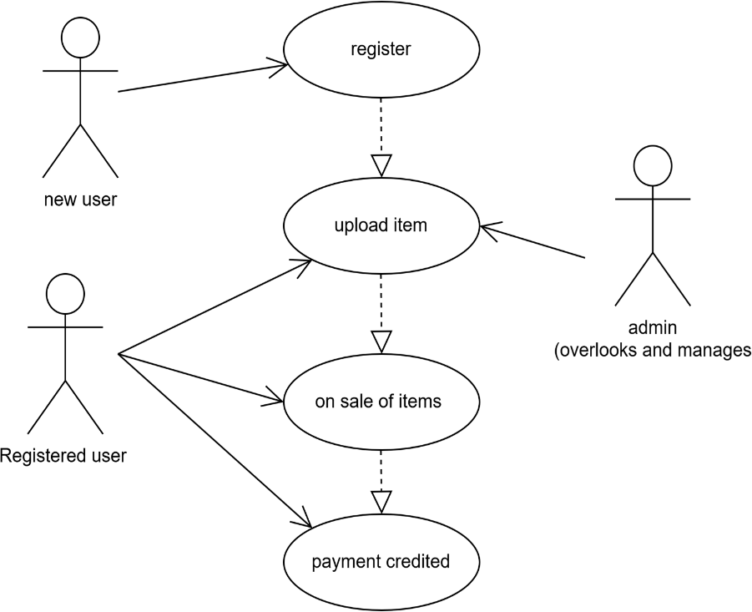
Use case…
1) Buyer
2) seller
.

Slide 12
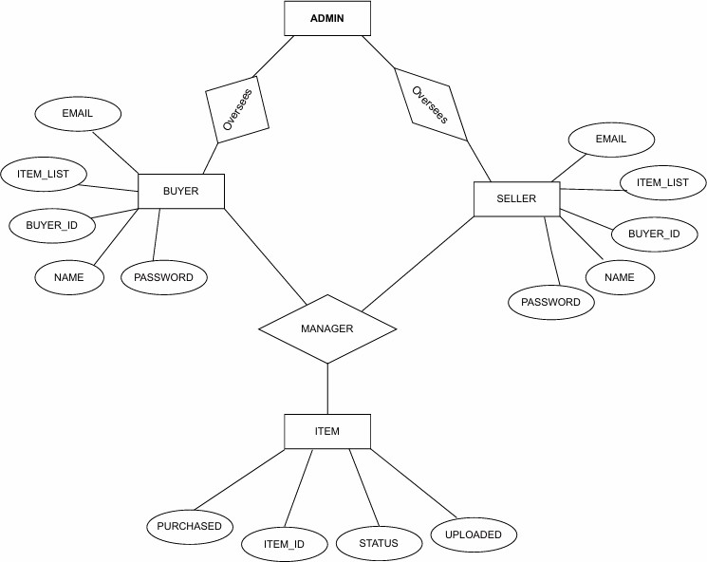
E-R Diagram
.

Slide 13

Data Dictionary
1) Table Name :Category
Table Description: category of products for sale
2) Table name :checkout/payment
Table Description : the record of the items sold and its details
Sr. No. | Field Name | Data type | Size | Constraints
1 | C_id | Integer | 3 | Primary Key
2 | C_name | Varchar2 | 15
Sr. No. | Field Name | Data type | Size | Constraints
1 | Name | Varchar2 | 20
2 | Id | Integer | 4 | Primary key
3 | Cost | Integer | 10
4 | Fname | Varchar2 | 10
5 | Lname | Varchar2 | 10
6 | Email | Varchar2 | 25
7 | Contact | Varchar2 | 10
8 | Address | Varchar2 | 100

Slide 14
Data Dictionary
3) Table name :cart
Table Description : list of products added to the cart .
4) Table name : admin
Table Description : admin username and password.
Sr. No. | Field Name | Data type | Size | Constraints
1 | Type | Varchar2 | 20
2 | Id | integer | 4
3 | Product_id | integer | 4 | Primary key
4 | Pname | Varchar2 | 20
5 | Cost | integer | 10
6 | Username | Varchar2 | 200
7 | Photo | Varchar2 | 100
Sr. No. | Field Name | Data type | Size | Constraints
1 | ID | integer | 3 | Auto increment
2 | Username | Varchar2 | 30 | Primary key
3 | Password | Varchar2 | 30

Slide 15
Data Dictionary
5) Table name : item
Table Description :list of products that are uploaded by the user through form .
Sr. No. | Field Name | Data type | Size | Constraints
1 | Type | Varchar2 | 20
2 | Id | integer | 4 | Primary key
3 | Pname | Varchar2 | 20
4 | Height | Float
5 | Width | Float
6 | Length | Float
7 | Pdate | Date
8 | Edate | Date
9 | Cost | integer | 10
10 | Info | Varchar2 | 200
11 | Photo | Varchar2 | 100
12 | Name | Varchar2 | 20
13 | Address | Varchar2 | 200
14 | Pincode | integer | 10
15 | contact | integer | 10

Slide 16
Data Dictionary
6) Table name : Login
Table Description : User name, password and email information of users.
Sr. No. | Field Name | Data type | Size | Constraints
1 | Username | Varchar2 | 15
2 | Password | Varchar2 | 15
3 | Email | Varchar2 | 25

Slide 17
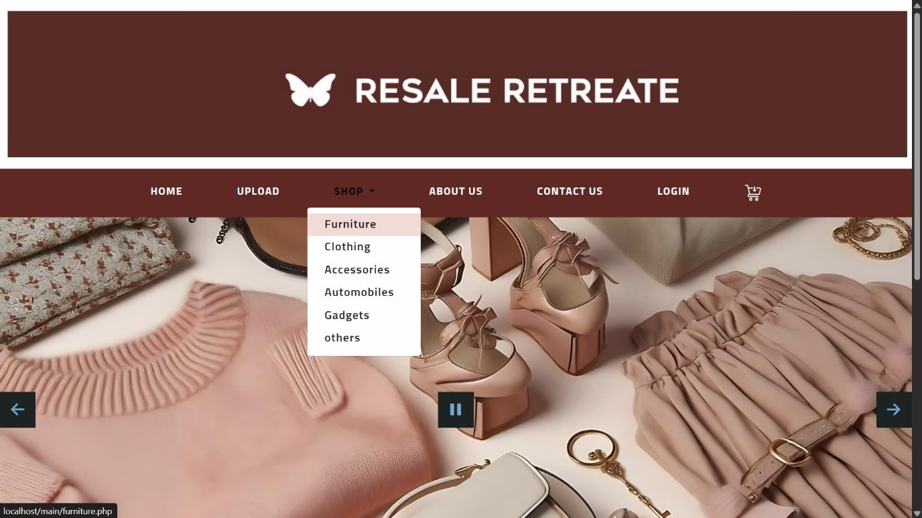
Screen Shots
1) Screen Name : Home Page
Screen Purpose: This is Home page of the website.
Screen Shot:

Slide 18
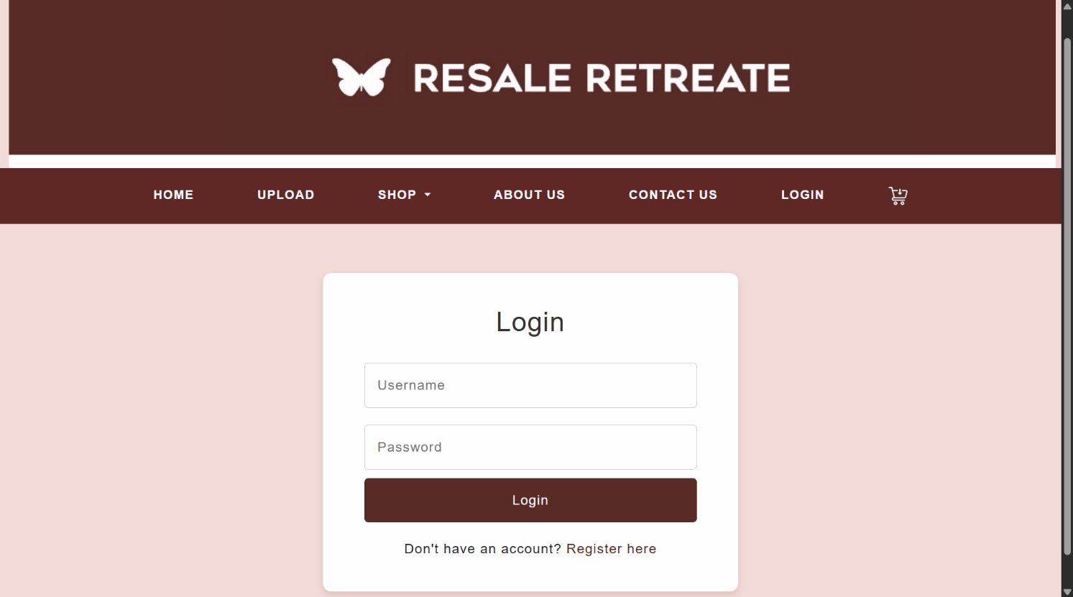
Screen Shots
2) Screen Name : Login/register Facilities
Screen Purpose: sign in/ sign up portals.
Screen Shot:

Slide 19
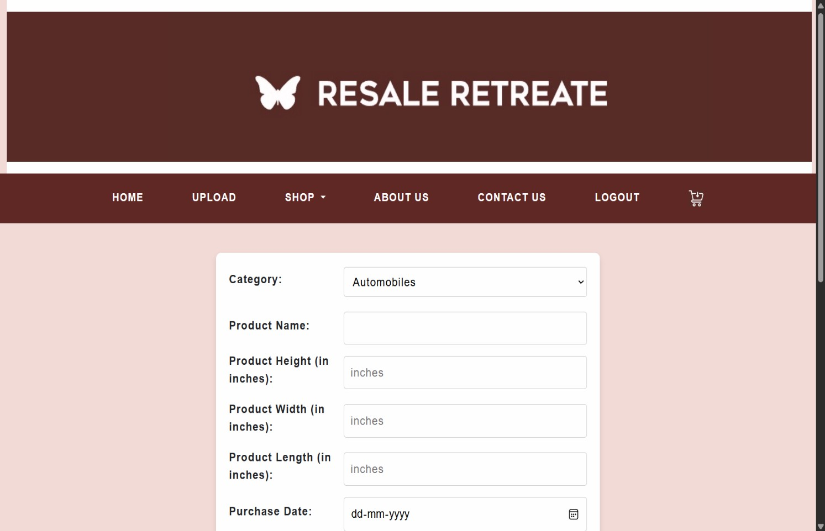
Screen Shots
3) Screen Name : upload
Screen Purpose: for uploading items on the website with the purpose to sell.
Screen Shot:

Slide 20
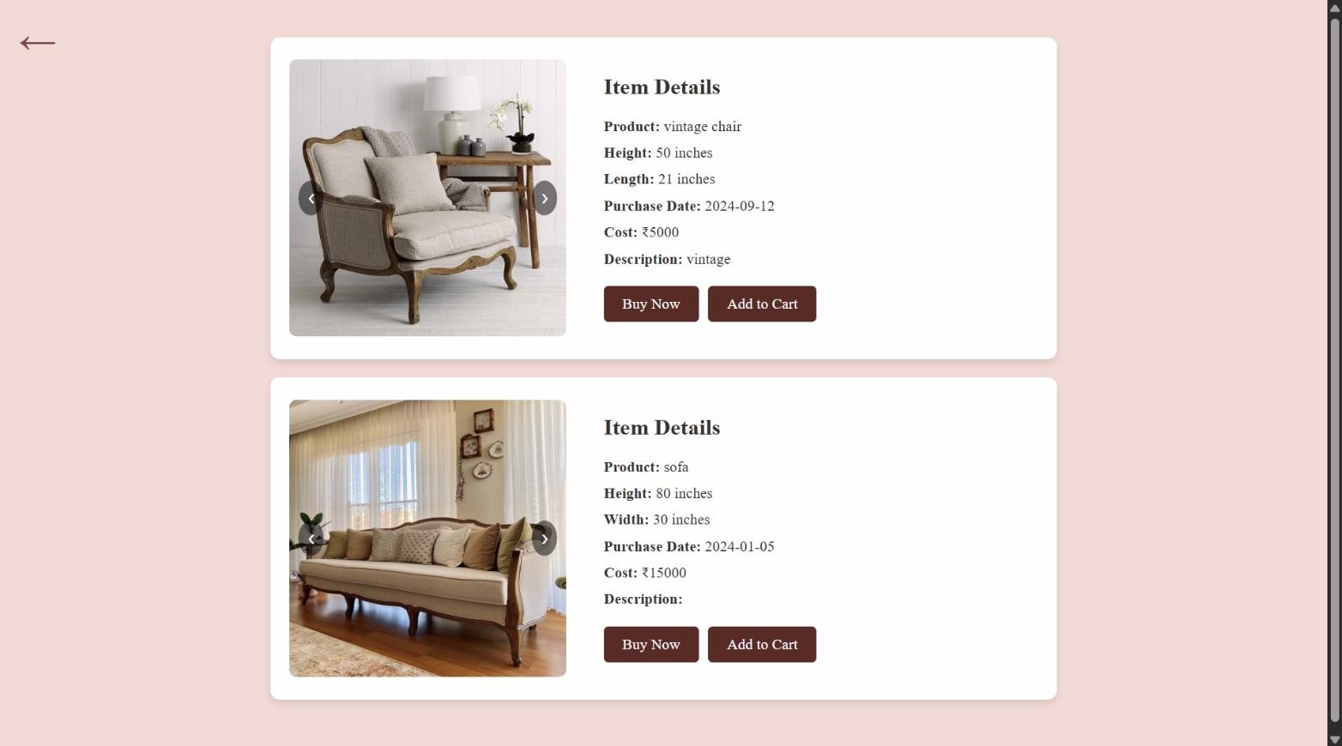
Screen Shots
4) Screen Name : Shop
Screen Purpose: to view and purchase items.
Screen Shot:

Slide 21
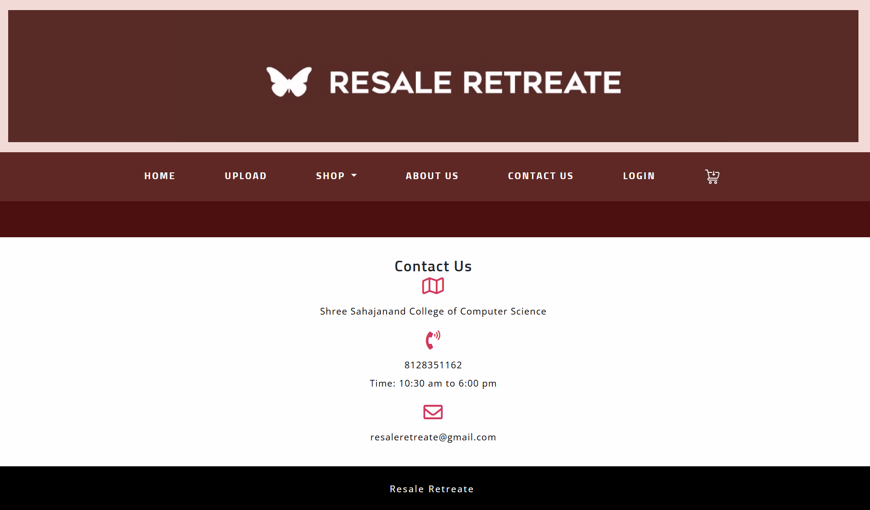
Screen Shots
5) Screen Name : contact us
Screen Purpose: customers can contact in case of query
Screen Shot:

Slide 22
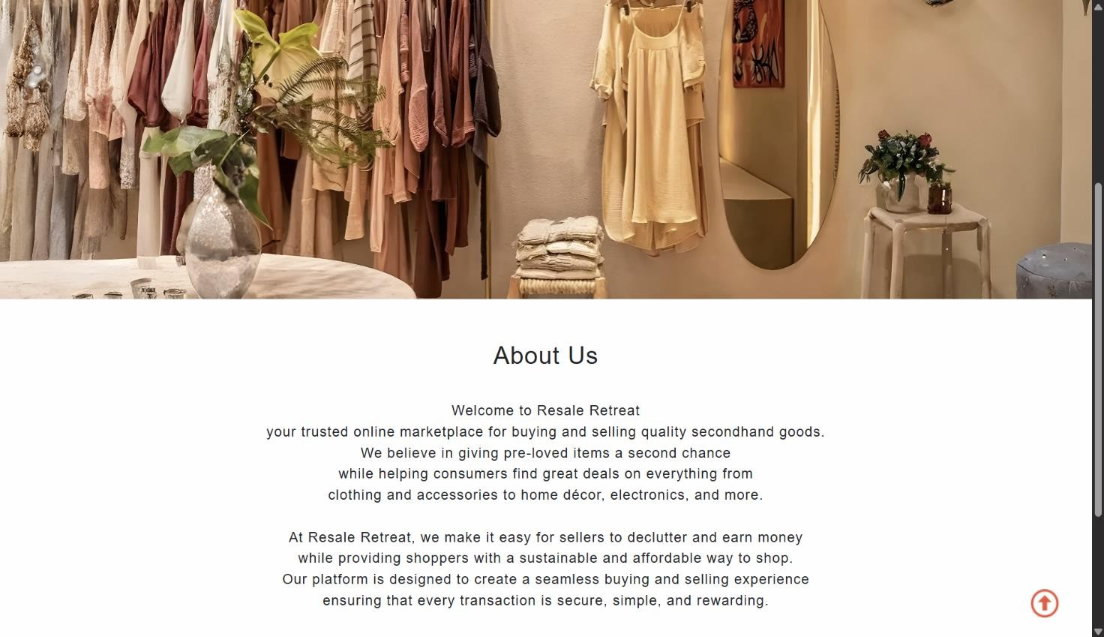
Screen Shots
6) Screen Name : About us
Screen Purpose: customers can get insight of website
Screen Shot:

Slide 23
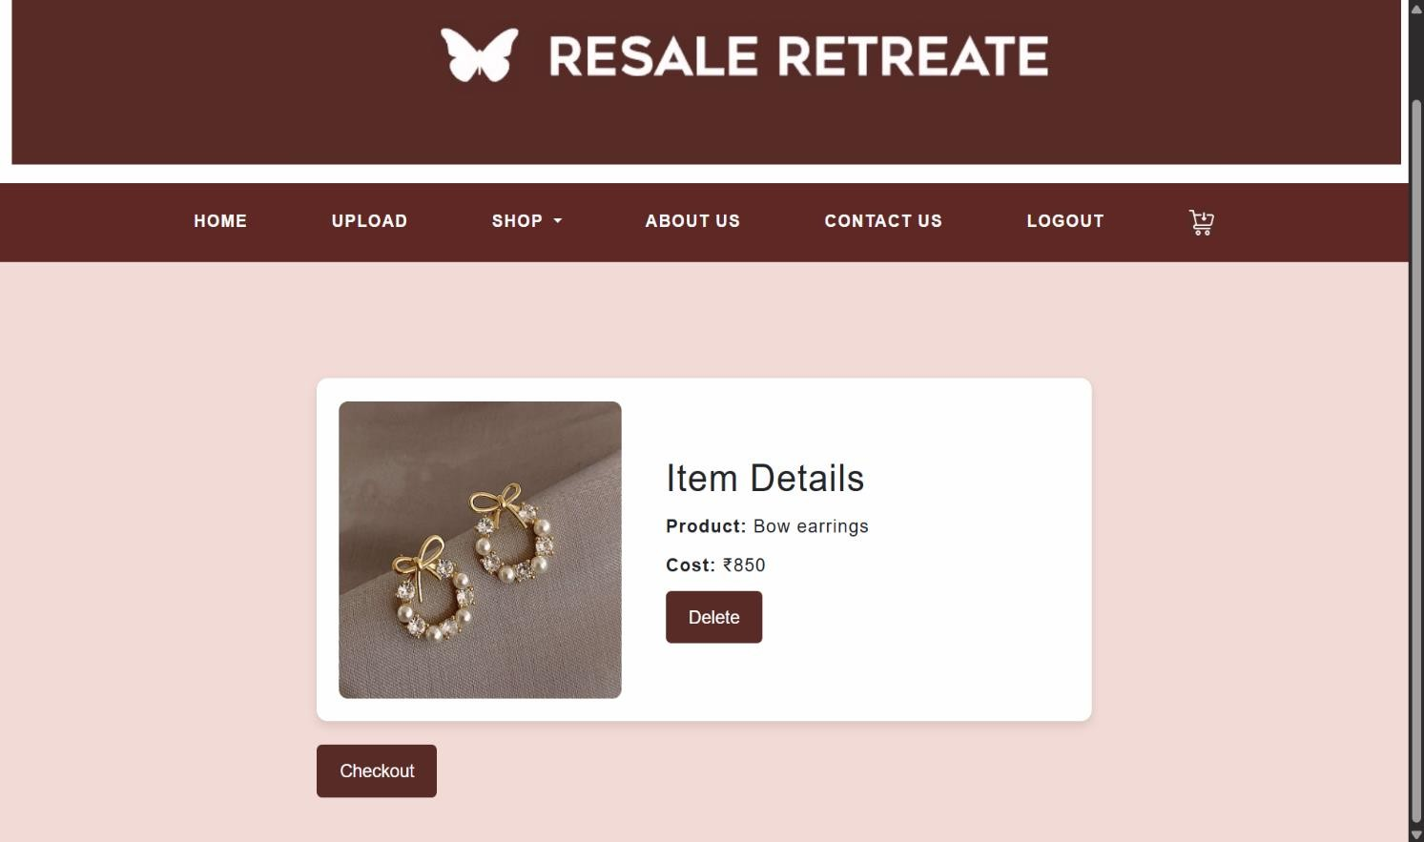
Screen Shots
7 ) Screen Name : cart
Screen Purpose : added to cart items and checkout
Screen Shot:

Slide 24
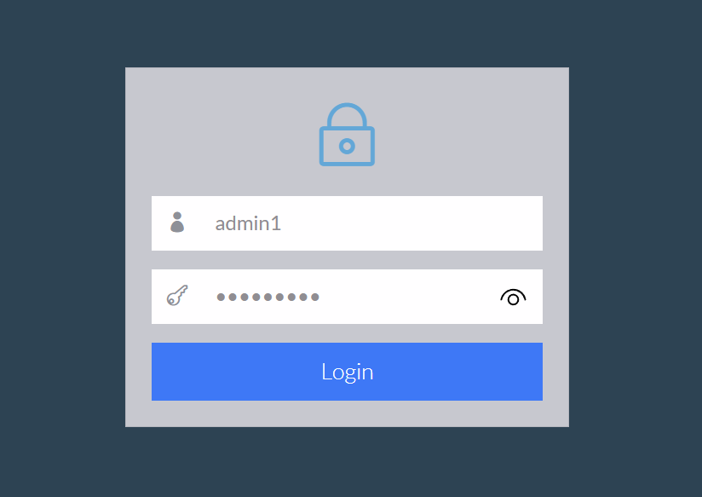
Screen Shots
8) Screen Name : admin panel
Screen Purpose : admin login panel
Screen Shot:

Slide 25
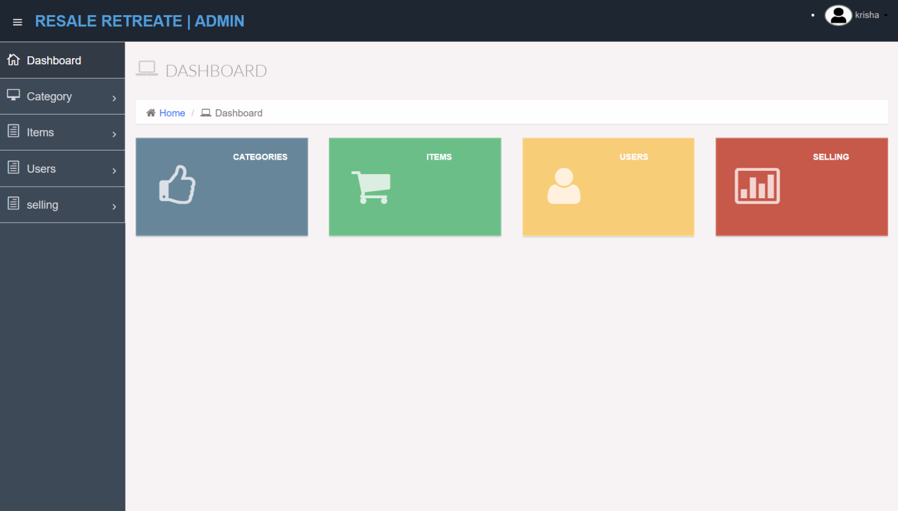
Screen Shots
9) Screen Name : Dashboard
Screen Purpose : main homepage
Screen Shot:

Slide 26
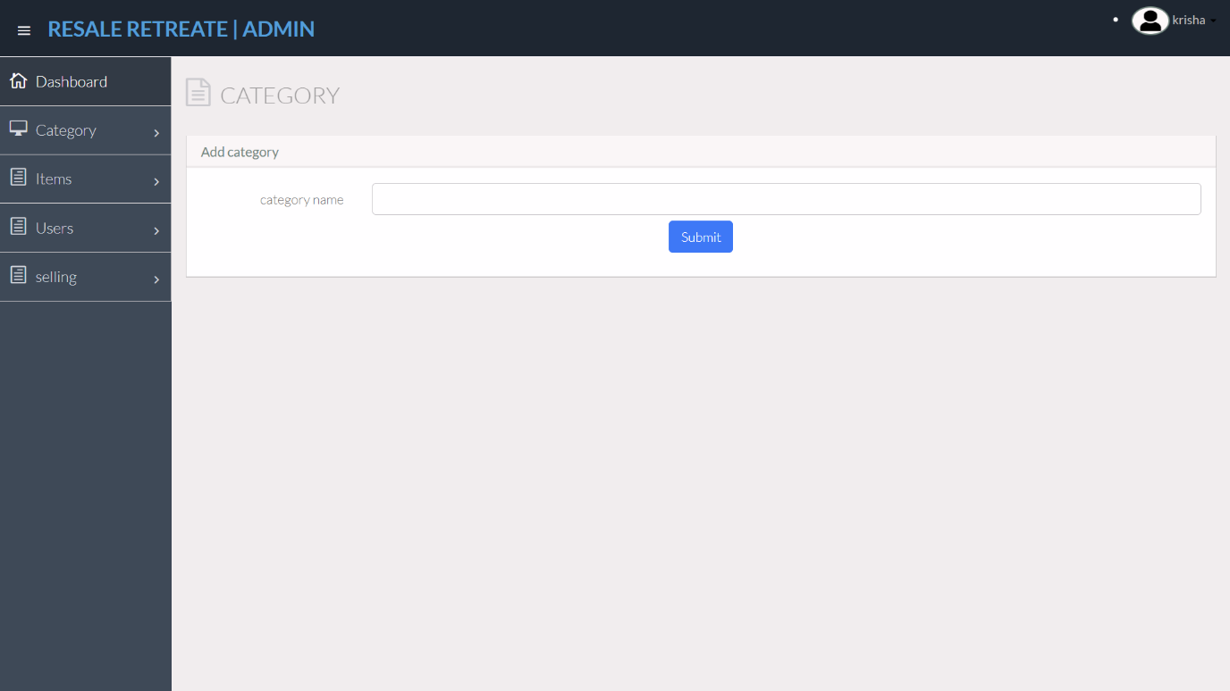
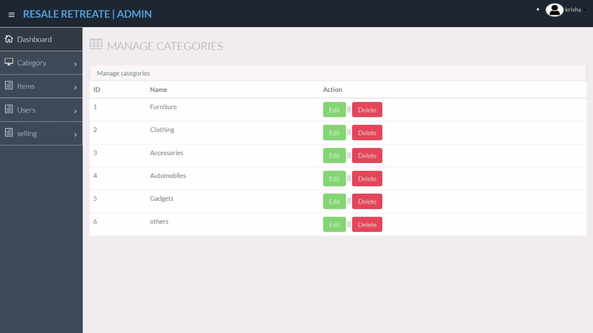
Screen Shots
10) Screen Name : category
Screen Purpose : add and manage dynamic categories
Screen Shot:

Slide 27
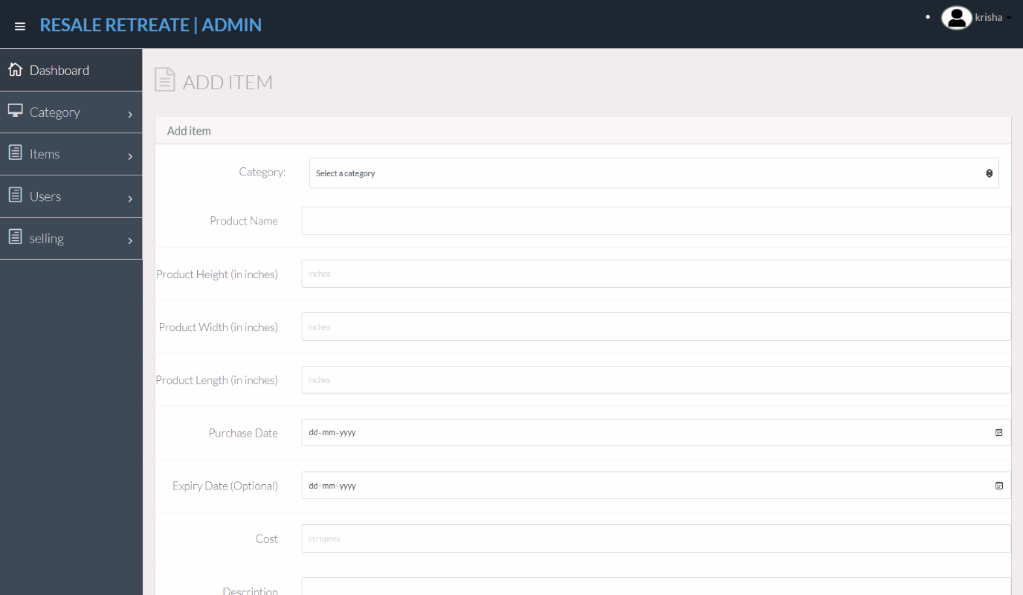
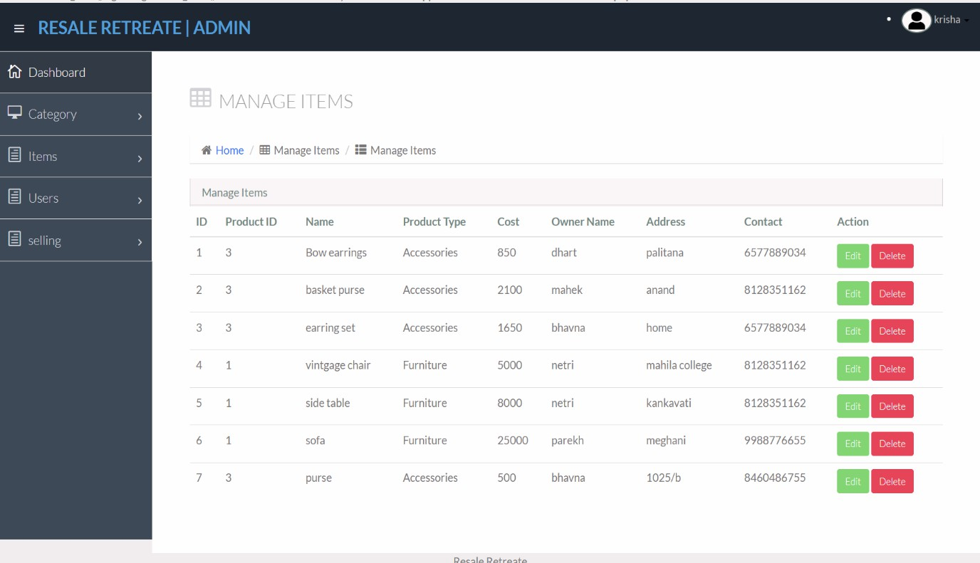
Screen Shots
11) Screen Name : Items
Screen Purpose : add and manage items upload
Screen Shot:

Slide 28
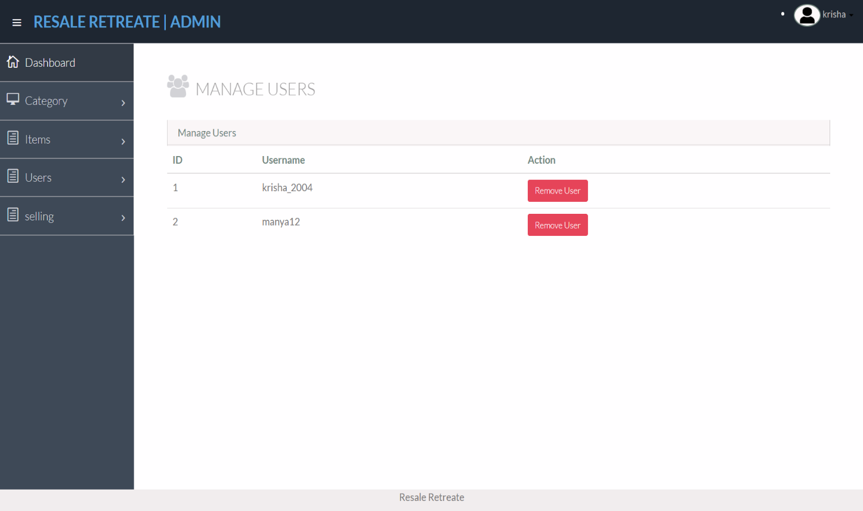
Screen Shots
12) Screen Name : Users
Screen Purpose : manage users
Screen Shot:

Slide 29
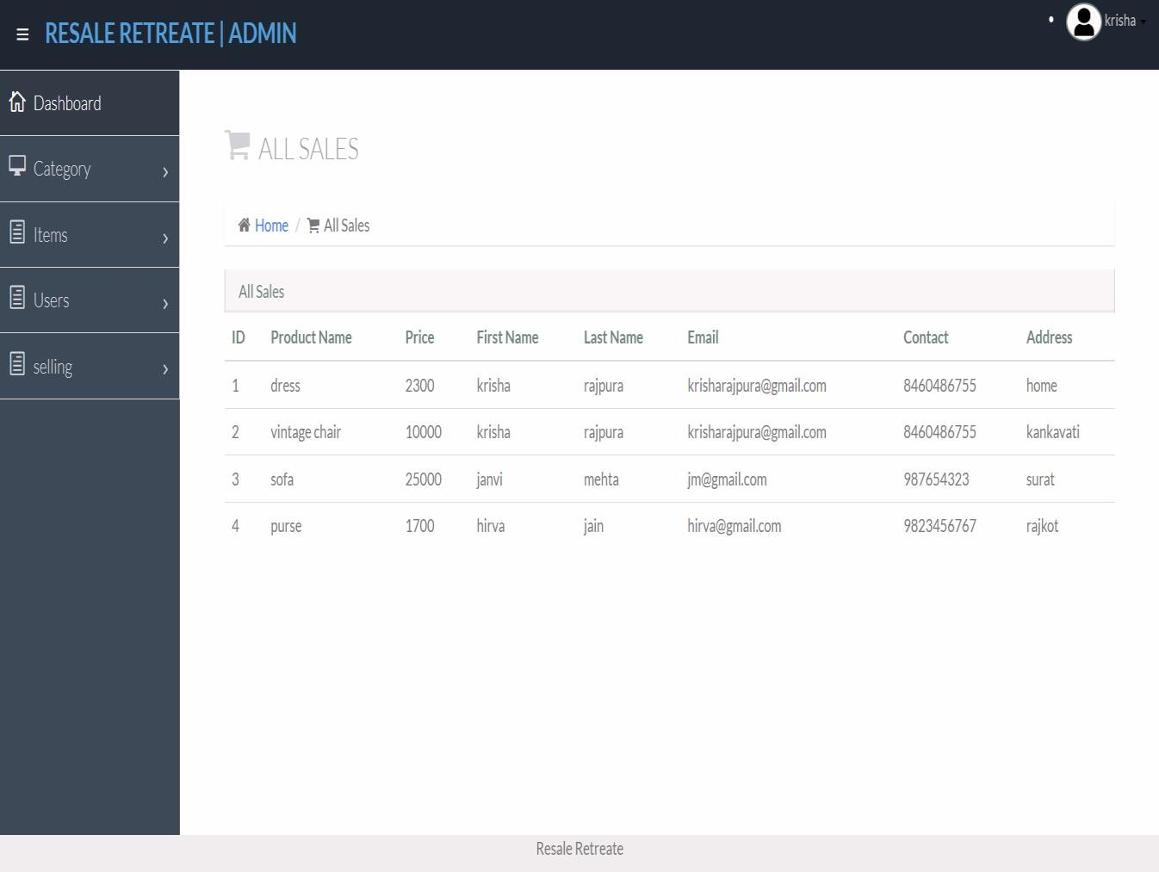
Screen Shots
13) Screen Name : sales
Screen Purpose : manage sales
Screen Shot:

Slide 30
Limitation of system
Trust and Safety: Ensuring trust and safety among users can be challenging. Concerns about the authenticity of products, fraudulent activities, and disputes between buyers and sellers need to be addressed.
Quality Control: Maintaining the quality of second-hand products can be difficult. Users might receive items that do not match the descriptions, leading to dissatisfaction and returns.
Market Competition: The C2C marketplace is highly competitive, with many established players. Differentiating Resale Retreat and attracting a loyal user base may require significant marketing efforts and unique value propositions.
Scalability: As the platform grows, scaling the infrastructure to handle increased traffic, transactions, and user data can be complex and costly.
Logistics and Delivery: Ensuring efficient and reliable logistics for the delivery of second-hand products can be challenging. Issues with shipping costs, delivery times, and handling returns must be managed effectively.
Payment Security: Ensuring secure and seamless payment processing is critical. Concerns about payment fraud and data breaches need to be addressed to maintain user trust.
Regulatory Compliance: Navigating the legal and regulatory requirements for operating a C2C platform in different regions can be complex. This includes issues related to taxation, consumer protection, and data privacy.

Slide 31
Future Scope of System
Expansion of Product Categories: Expand the range of product categories to include more niche markets, such as vintage items, collectibles, and handmade crafts, to attract a wider audience and increase user engagement.
Integration of AI and Machine Learning: Enhance the user experience by providing personalized recommendations, improving search functionality, and detecting fraudulent activities using AI and machine learning algorithms.
Sustainability Initiatives: Emphasize the environmental benefits of buying and selling second-hand products. Introduce features that highlight the positive impact on reducing waste and promoting sustainability.
Mobile App Development: Develop a user-friendly mobile app to increase user retention and engagement by making it easier for users to access the platform on the go.
Social Features: Add social features such as user profiles, reviews, and ratings to build a sense of community and trust among users, encouraging more transactions and repeat customers.
Partnerships and Collaborations: Collaborate with other businesses, influencers, and organizations to promote the platform and reach a larger audience, increasing brand visibility.
Enhanced Payment and Delivery Options: Offer multiple payment options and efficient delivery services to improve the overall user experience. Explore partnerships with logistics companies to streamline the delivery process.

Slide 32
Bibliography
Funda with webIT : admin panel and website overview and tutorials .
Programming with vishal : coding and logic reference for the website .
W3schools : introduction and basic knowledge about php language .
Thinkswithyou : website code and interface reference .

Slide 33
.
Thank you !

